Slide 1
MTH1203: Probability and Statistics
Inferential Statistics
GROUP_7
MIREMBE PEACE MERCY .....M24B23/005
MUKIDI ANDREW......................M24B23/035
RAYMOND JAMES M................M24B13/047
EDEKEI JUSTIN WYCLIFF.......M24B38/012
WARUDATA NATUKUNDA...M24B23/023
SSUUBI STEPHEN.......................M24B13/007
IFEMENE PAUL............................M24B13/034
CHURCHILL OGENRWOT......M24B13/028
ANGELLA KYAZZE.....................M24B13/041
RAYMOND JAMES M................M24B13/047
Fri 8th Nov 2024

Slide 2
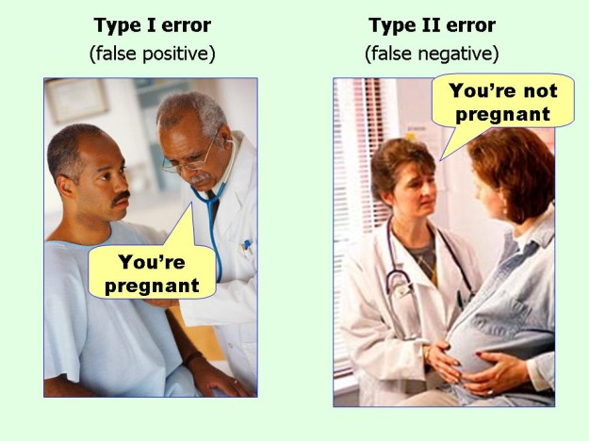

Slide 3
ERRORS IN HYPOTHESIS TESTING
TYPE ONE ERROR
TYPE TWO ERROR
Also known as “false positive”
This error occurs when one rejects a true null hypothesis.
For example making a conclusion that a man is pregnant.
Also known as “false negative”
This error occurs when one accepts a false null hypothesis.
For example making a conclusion that a pregnant woman is not pregnant.

Slide 4
Type one errors

Slide 5



Type I Errors in Hypothesis Testing
01
02
Significance Level
Type I Error Rate
Probability of incorrectly rejecting a true null hypothesis.
Controlling the likelihood of making a Type I error.

Slide 6
01: Significance level
Significance level serves as a threshold in hypothesis testing to decide whether the results are statistically significant or not.
The commonly used threshold values 0.05 and 0.01 correspond to to a 1% and 5% respectively chance of rejecting the null hypothesis when it actually true.
The level of significance chosen depends on the context of the study, in very sensitive cases 0.01 is preferred otherwise 0.05

Slide 7
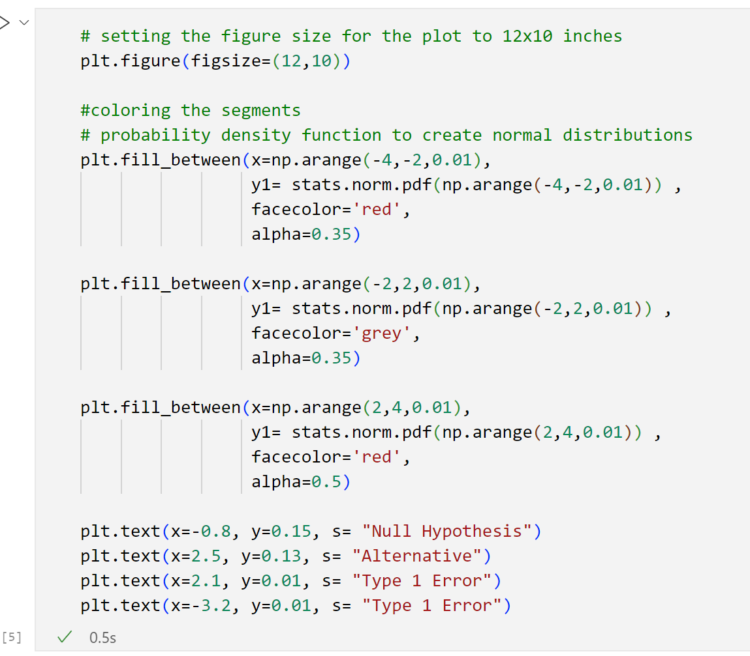
Visualising the type one error (The two tail test)

Slide 8
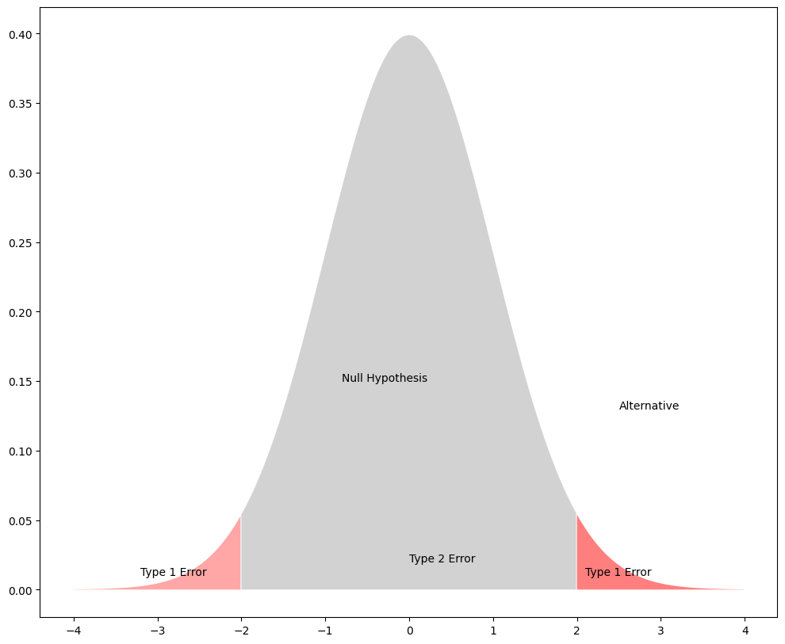
Visualization of the type one error

Slide 9
02: Type one error rate
Type one error rate is the probability of rejecting the null hypothesis yet it is true.
The significance level is a test put in place to keep the error rate low

Slide 10
Type two errors

Slide 11
Type II Errors in Hypothesis Testing
Probability of Failing to Reject Null
Factors Affecting Type II Error
Controlling Type II Error

Slide 12
02:Probability of Failing to Reject Null Hypothesis
If the null hypothesis is false then the probability of a type two error is denoted by “beta”
NOTE: A type two error simply implies that the data does not provide enough evidence for us to conclude that the null hypothesis is false.

Slide 13
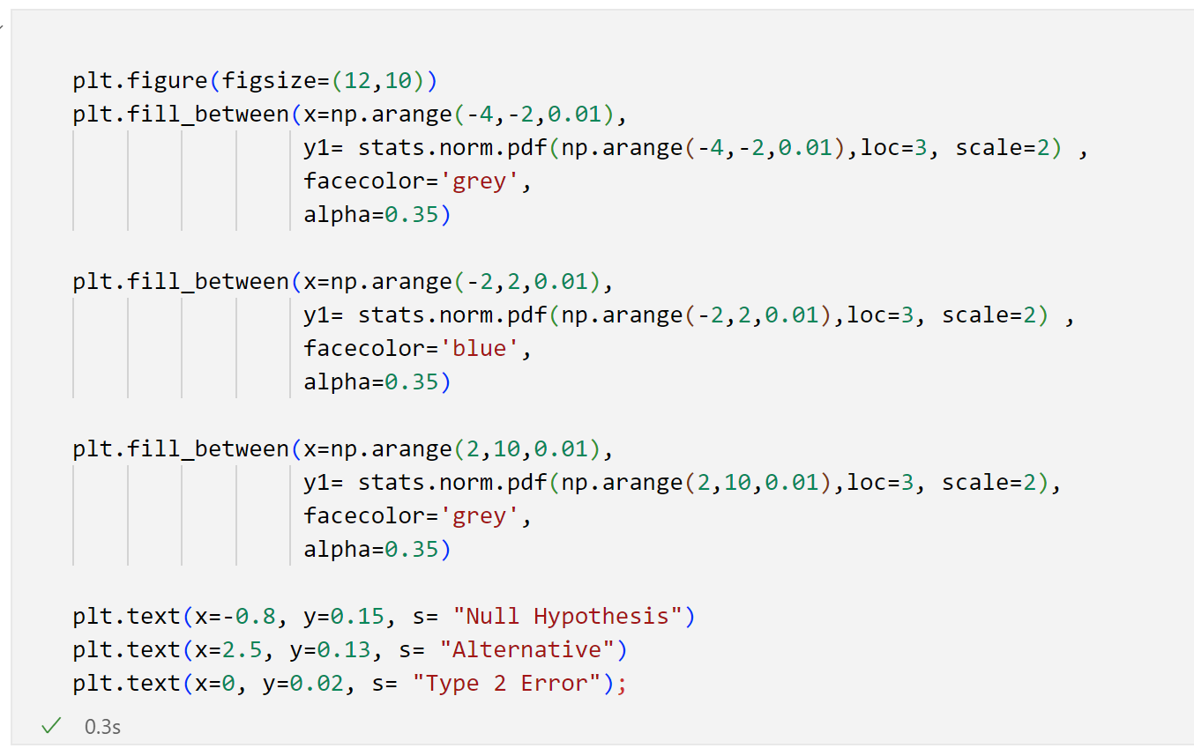
Visualising the type two error (The code)

Slide 14
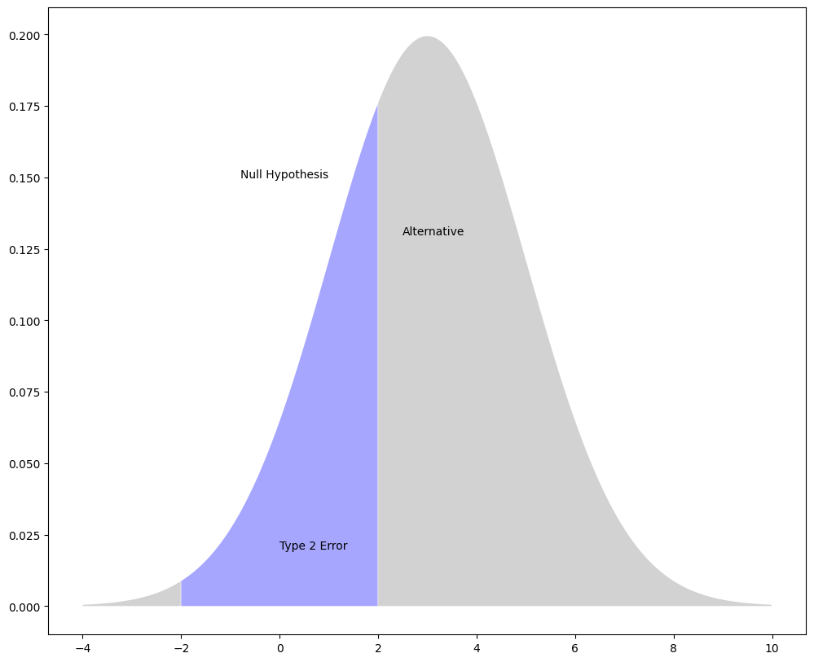
Visualization

Slide 15
02: Factors affecting the type two error
Sample size: A smaller sample size reduces the test’s ability to detect a true effect
Effect size: The smaller the true effect or difference, the harder it is to detect a type two error
Variability: Greater variability in the data can mask the effect being tested for
Significance level: Setting a low significance level makes it harder to reject the null hypothesis.

Slide 16
03: Controlling a type two error
Increase the sample space to provide more data for detecting an effect.
Use more precise measurement tools to reduce too much variations in the data
Design the experiment in such a way that the conditions are controlled and consistent
Adjust the level of significance

Slide 17

Mitigating for Statistical Errors
Understand Significance Levels
Employ Robust Statistical Methods
Conduct Power Analysis
Determine appropriate alpha values to control Type I and II errors.
Use techniques like bootstrapping to reduce sensitivity to outliers.
Estimate required sample sizes to achieve desired statistical power.

Slide 18
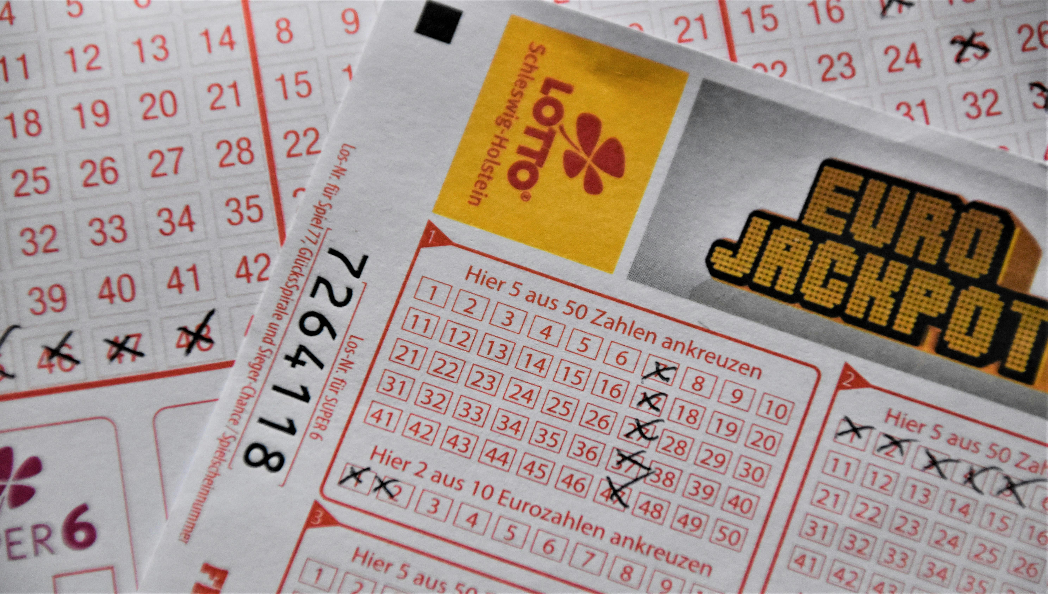
RANDOM PROCESSES

Slide 19
RANDOM PROCESSES
A random process is a collection of random variables indexed by time.
OR
In Probability and Statistics, a random process is a mathematical representation of a sequence of events or outcomes that occur randomly over time.

Slide 20

Examples of random processes
1. Coin tosses
2. Rolling dice
3. Stock market fluctuations
4. Weather patterns
5. Radio signal noise
6. Arrival times of customers at a store
7. Number of phone calls received per hour

Slide 21
Let N(t)be the number of customers who have visited a store from t=9(when the store opens at 9:00 am) until time t, on a given day, for t∈[9,16]. Here, we measure t in hours, but t can take any real value between 9 and 16. We assume that N(9)=0, and N(t)∈{0,1,2,...} for all t∈[9,16]. Note that for any time t1, the random variable N(t1)is a discrete random variable. Thus, N(t) is a discrete-valued random process. However, since t can take any real value between 9 and 16, N(t) is a continuous-time random process.
RANDOM PROCESSES continued......

Slide 22
EXPLANATION

Slide 23

Applications of random processes
Signal Processing
Communication Systems
Financial Modeling
Reliability Engineering
Machine Learning

Slide 24
Real-life random processes
Signal Processing: In phone calls, we deal with random noise in the signal, so we design filters to get a clearer sound.
Time Series Analysis: Economists look at past stock prices to try to predict trends.
Communication: Engineers model random interference in wireless signals to improve mobile networks.
Queuing Theory: In places like airports, knowing random arrival patterns helps plan for busy and slow times.
Reliability: Engineers use random processes to estimate when machines might break down so they can fix them before they fail.

Slide 25


Key Characteristics
Uncertainty
Randomness
Independence
The outcome of each event is uncertain and cannot be predicted with certainty.
The events occur randomly, without a predictable pattern
Often, each event doesn’t depend on the last. Tossing a coin now doesn’t affect the outcome of the next toss.

Slide 26

Key Characteristics continued........
Time or Space: The process evolves over time or space.

Slide 27
Types of random processes
Discrete-Time Random Process: Imagine flipping a coin every second. The results (heads or tails) are recorded at each time step. This type of process unfolds at specific, separate points in time.
Continuous-Time Random Process: Imagine watching the stock market prices tick up and down all day. Prices can change at any moment, not just at fixed times. Here, time flows smoothly, and changes happen continuously.
Discrete-Valued Random Process: Suppose you’re counting the number of cars that pass by each minute. The count for each minute is a whole number (like 2 cars, 5 cars), so the results are “discrete” values, meaning separate numbers.
Continuous-Valued Random Process: Imagine measuring the temperature throughout the day. The temperature can take on any value, like 72.5 or 68.3 degrees, so it’s a continuous value, not just fixed steps.

Slide 28
Important Concepts
Stationarity: Imagine recording daily temperatures. If you find that average temperatures stay about the same over months, that’s a sign of stationarity—things don’t change wildly over time.
Ergodicity: Let’s say you measure traffic on a road all day. If you could look at that day’s data and predict future days accurately, that’s ergodicity—one day's data reflects the bigger picture.
Autocorrelation: Suppose you’re checking the temperature every hour. The temperature at 1 PM might be similar to that at 2 PM, but much different from midnight. Autocorrelation tells us how linked values are over time.
Power Spectral Density (PSD): This is like analyzing a song to find which notes or sounds repeat most often. For signals (like radio waves), PSD helps us understand what frequencies (high or low sounds) are strongest.

Slide 29
Mathematical Representation
Probability Distributions: These are like maps showing how likely different outcomes are. For a dice roll, each number (1–6) has an equal chance.
Markov Chains: Imagine walking from room to room in a house where each room only connects to certain others. Each step only depends on your current room, not how you got there. This is useful for processes with “memoryless” steps.
Stochastic Differential Equations (SDEs): SDEs are equations used for things that change unpredictably but gradually, like stock prices.
Fourier Analysis: Think of Fourier analysis as breaking down a complex song into simpler notes. In random processes, it helps identify regular patterns hidden in noisy data.

